Slide 1

Exploration vs. Exploitation in Monte Carlo Methods
The exploration vs. exploitation trade-off is a foundational concept in Monte Carlo inference and reinforcement learning. This critical balance shapes how algorithms make decisions in uncertain environments, whether in game playing, sequential optimization, or complex decision-making scenarios.
Muhammad Saeed

Slide 2
Understanding the Core Dilemma
Exploitation
Exploration
The Challenge
Choosing actions or paths that have previously yielded high rewards or accurate estimates. It focuses on making the best use of current knowledge to maximize immediate returns.
Choosing less-tried or untested actions to gather more information. The aim is to discover potentially better options that are currently underestimated or unknown.
Finding the optimal balance between these two strategies to maximize long-term rewards or accuracy, as focusing too much on either can lead to suboptimal outcomes.

Slide 3



Monte Carlo Inference Fundamentals
Random Sampling
Adaptive Sampling
Efficiency vs. Accuracy
Monte Carlo inference uses random sampling to approximate integrals or probabilities, especially when analytic solutions are difficult to compute.
The exploration-exploitation trade-off arises in adaptive sampling, where the goal is to efficiently sample from a distribution or state space.
Balancing between exploiting known high-value regions and exploring unknown areas is crucial for both computational efficiency and statistical accuracy.

Slide 4

Monte Carlo Tree Search (MCTS)
Selection
Traverse the tree from the root using a strategy like UCT until reaching a leaf node, balancing between promising and unexplored paths.
Expansion
Add new children to the leaf node, expanding the search space to include previously unexplored options.
Simulation (Rollout)
Simulate to a terminal state using some policy (often random) to estimate the value of the new position.
Backpropagation
Update statistics (rewards, visit counts) up the tree to inform future selections and improve estimates.

Slide 5
The UCT Algorithm
The UCT (Upper Confidence Bound applied to Trees) formula provides a mathematical approach to balance exploration and exploitation in MCTS:
Score = X̄_j + c · √(ln N / n_j)
Exploitation Component
Exploration Component
X̄_j: Average reward of action j
c · √(ln N / n_j)
This term encourages selecting actions that have historically yielded high rewards, focusing on exploitation of known good options.
n_j: Number of times action j was tried
N: Total simulations so far
c: Exploration constant (tuning parameter)
This term encourages exploration of less-tried actions, with the bonus decreasing as an action is selected more frequently.

Slide 6




Importance Sampling in Monte Carlo
Target Distribution
p(x): The distribution we want to estimate
Proposal Distribution
q(x): The distribution we sample from
Importance Weights
w(x) = p(x)/q(x): Corrects the mismatch
Adaptive Refinement
Adjust q(x) based on previous samples
In adaptive importance sampling, the exploration-exploitation trade-off manifests as choosing between sampling from regions where q(x) is already known to give high weight (exploit) versus sampling from less-known regions to avoid missing important contributions (explore).

Slide 7
Risks of Imbalance
Over-Exploitation Risks
Over-Exploration Risks
Missing out on better options that haven't been sufficiently explored
Wasting computational resources on clearly inferior options
Getting stuck in local optima rather than finding global solutions
Slow convergence to good solutions due to excessive randomness
Developing biased estimates, especially if initial samples are misleading
High variance in estimates from constant shifting of focus
Premature convergence to suboptimal solutions
Inefficient use of limited sampling budget

Slide 8



Balancing Strategies: UCT and Epsilon-Greedy
UCT (in MCTS)
Epsilon-Greedy
Annealing
Mathematical approach using confidence bounds to balance exploration and exploitation. The exploration term naturally decreases as nodes are visited more frequently.
Choose random action with probability ε (exploration), and select the best-known action with probability 1-ε (exploitation). Simple but effective in many scenarios.
Gradually decrease the exploration parameter over time, starting with high exploration and shifting toward exploitation as knowledge improves.

Slide 9








Balancing Strategies: Probabilistic Approaches
Softmax/Boltzmann
Thompson Sampling
Converts rewards into probabilities, with a temperature parameter controlling randomness. Higher temperature means more exploration.
Samples from posterior distributions of rewards to naturally balance based on uncertainty. More uncertainty leads to more exploration.
Bayesian Optimization
Contextual Bandits
Uses acquisition functions like Upper Confidence Bound (UCB) or Expected Improvement (EI) to guide exploration based on predicted value and uncertainty.
Adapts exploration based on context or state, allowing for more intelligent exploration in relevant situations.

Slide 10



Application: Game AI
Traditional Games
Chess, Go, and other board games use MCTS to balance between exploring new move sequences and exploiting known strong lines.
Neural Network Integration
AlphaGo and AlphaZero combine MCTS with deep neural networks, using learned policies to guide exploration more efficiently.
Advanced AI Systems
Modern game AI uses sophisticated exploration strategies that adapt based on game state, time constraints, and opponent modeling.
In game AI, the exploration-exploitation balance is crucial for discovering novel strategies while still playing competitively. Too much exploitation leads to predictable play, while too much exploration results in weak, random moves.

Slide 11



Application: Planning and Robotics
In robotics and autonomous systems, the exploration-exploitation trade-off is essential for effective planning. Systems must balance between following known efficient paths (exploitation) and discovering potentially better alternatives or adapting to changing environments (exploration).
This balance becomes particularly critical in dynamic environments where conditions change frequently, requiring continuous adaptation of the exploration strategy.

Slide 12
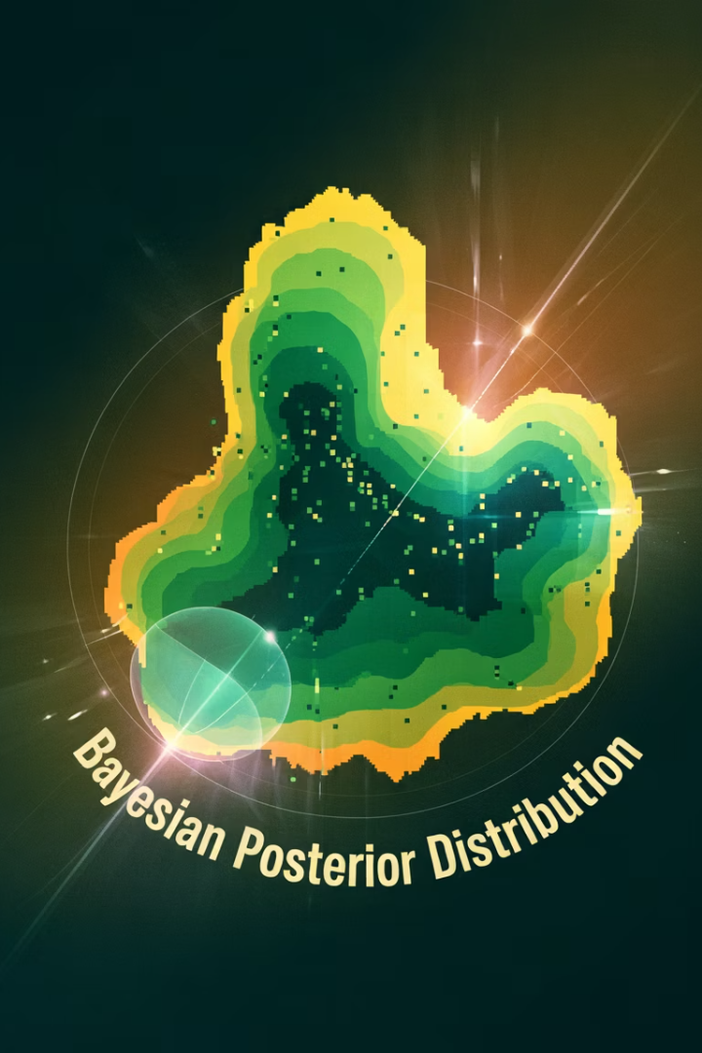
Application: Bayesian Inference
1000x
95%
Efficiency Gain
Coverage
Potential improvement in sampling efficiency with adaptive methods vs. simple Monte Carlo
Typical target for distribution coverage in high-dimensional problems
10-30%
Exploration Budget
Typical allocation of samples for exploration in adaptive schemes
In Bayesian inference, particularly with complex posterior distributions, adaptive importance sampling methods must carefully balance between exploiting high-density regions and exploring the tails of distributions. This balance is crucial for accurate estimation of posterior expectations, especially for multi-modal distributions or when calculating rare event probabilities.

Slide 13


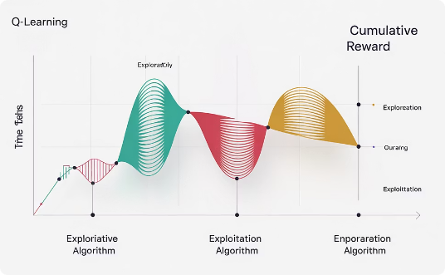
Application: Multi-Armed Bandits
Classical Bandit Problem
Real-World Applications
Performance Metrics
The multi-armed bandit problem involves choosing between multiple options (like slot machines) with unknown reward distributions. The goal is to maximize cumulative reward by balancing between playing machines with historically high payouts (exploitation) and trying less-played machines to learn their payouts (exploration).
This framework applies to numerous real-world scenarios: A/B testing in marketing, clinical trials for drug testing, adaptive routing in networks, and recommendation systems. In each case, there's a fundamental trade-off between gathering more information and leveraging existing knowledge.
The effectiveness of bandit algorithms is often measured by regret—the difference between the reward obtained and what could have been obtained with perfect knowledge. Different exploration strategies lead to different regret profiles over time.

Slide 14
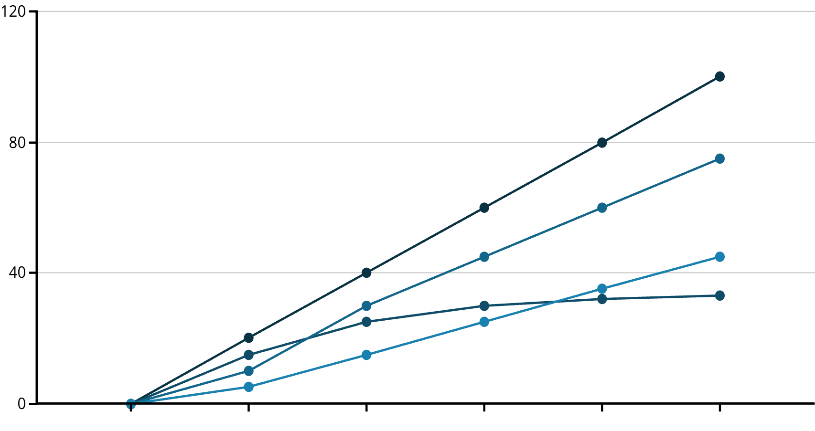
Mathematical Implications
Time Steps
Pure Exploitation
Balanced Approach
Pure Exploration
The chart illustrates how different exploration-exploitation strategies affect cumulative reward over time. Pure exploitation starts strong but plateaus as it gets stuck in local optima. Pure exploration builds knowledge but accumulates reward slowly. The balanced approach eventually outperforms both, demonstrating the long-term benefit of proper balance.
Mathematically, this balance ensures convergence to optimal policies, reduced variance in estimates, and lower regret over time—but only if exploration is sufficient to eventually visit all options infinitely often, albeit at a decreasing rate.

Slide 15
Theoretical Guarantees
1
Asymptotic Convergence
2
Regret Bounds
With sufficient exploration, Monte Carlo methods will converge to the true values or optimal policies as the number of samples approaches infinity, regardless of initial estimates.
Many exploration strategies come with theoretical upper bounds on cumulative regret, often scaling logarithmically with the number of actions taken, proving their efficiency.
3
Exploration Requirements
4
Finite-Time Performance
Theoretical guarantees typically require that every option is visited infinitely often, though at a decreasing rate that allows exploitation to dominate in the limit.
Beyond asymptotic guarantees, modern algorithms also focus on minimizing regret or error within finite time horizons, which is more relevant for practical applications.

Slide 16
Practical Implementation Considerations
Parameter
Effect on Exploration
Typical Values
Adjustment Strategy
UCT constant (c)
Higher c = more exploration
1.0 - 2.0
Domain-specific tuning
Epsilon (ε)
Directly controls exploration probability
0.05 - 0.2
Decrease over time
Temperature (τ)
Higher τ = more uniform selection
0.1 - 1.0
Anneal from high to low
Prior weight
Stronger prior = less initial exploration
Domain-dependent
Decrease as data accumulates
When implementing exploration strategies in practice, parameter tuning becomes crucial. The optimal balance depends heavily on the specific problem characteristics, available computational resources, and time constraints. Many successful implementations use adaptive parameters that change over time, starting with high exploration and gradually shifting toward exploitation.

Slide 17








Case Study: AlphaGo
Superhuman Performance
Defeated world champions in Go
Neural Network Guidance
Policy and value networks direct search
Advanced MCTS
Sophisticated tree search algorithm
Exploration-Exploitation Balance
Core principle behind its success
AlphaGo represents one of the most successful applications of the exploration-exploitation balance in practice. It uses MCTS guided by deep neural networks to efficiently explore the vast game tree of Go. The system balances between exploring promising but uncertain moves suggested by its policy network and exploiting known strong positions evaluated by its value network.
This balance allowed AlphaGo to discover novel strategies that surprised human experts while still playing consistently strong moves, demonstrating the power of well-tuned exploration in complex domains.

Slide 18
Emerging Approaches
Meta-Learning for Exploration
Information-Theoretic Exploration
Using machine learning to learn optimal exploration strategies themselves, rather than hand-designing them. These approaches can adapt the exploration strategy based on the specific characteristics of the problem domain.
Defining exploration objectives based on information gain or entropy reduction, leading to more principled exploration that targets the most informative actions rather than simply the least-visited ones.
Intrinsic Motivation
Hierarchical Exploration
Incorporating curiosity or novelty as intrinsic rewards to drive exploration, inspired by human learning. This approach can help discover useful skills or knowledge even in the absence of external rewards.
Exploring at multiple levels of abstraction simultaneously, allowing for more efficient exploration of large or complex state spaces by focusing on meaningful high-level options.

Slide 19





Challenges and Open Questions
Non-Stationary Environments
How to balance exploration and exploitation when the underlying distributions or rewards are changing over time? Adaptation becomes even more critical in dynamic environments.
High-Dimensional Spaces
Traditional exploration strategies often struggle in very high-dimensional spaces where the curse of dimensionality makes comprehensive exploration impossible. How can we explore efficiently in such spaces?
Safety Constraints
In many real-world applications, exploration carries risks. How can we balance the need for exploration with safety constraints that limit the potential negative outcomes of exploratory actions?
Transfer Learning
Can exploration knowledge be transferred between related tasks to improve efficiency? Leveraging prior experience to guide exploration in new but similar domains remains challenging.

Slide 20




Key Takeaways
Fundamental Trade-off
Mathematical Solutions
Wide Applications
Evolving Field
Research continues to develop more sophisticated approaches to this fundamental challenge, with promising directions in meta-learning, information theory, and hierarchical methods.
The exploration-exploitation balance is not just a conceptual issue but a mathematical one that deeply affects the efficiency, accuracy, and convergence of Monte Carlo algorithms.
Algorithms like UCT, epsilon-greedy, and Thompson sampling provide principled approaches to balance exploration and exploitation based on accumulated knowledge and uncertainty.
This trade-off appears across numerous domains: game AI, robotics planning, Bayesian inference, online learning, and optimization of expensive functions.

